Slide 1
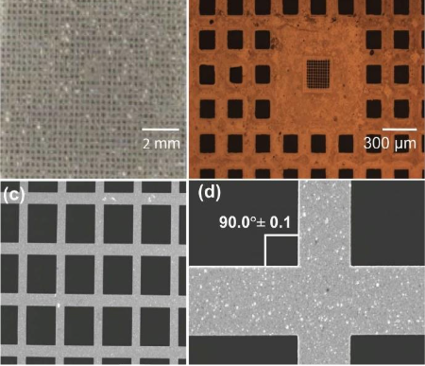
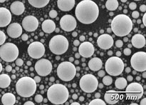

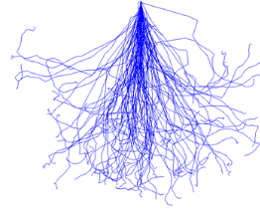

Resolution Determination Methods and Discussion
Edge Scanning scans edges of features, resulting line profile fitted using mathematical function to determine resolution [3]
Spherical RS relies on curvature at the side; Grids with straight side-walls may perform better, eliminating error introduced by curvature of sphere
Gap Scanning scans gaps between adjacent features [4]
No fixed gap sizes for spherical RS, best resolution depends on smallest gap available; Edge Scanning with Grids only utilises side-wall straightness, eliminating physical limits of gaps
Resolution Standards
Overview
Used for calibrating and characterising spatial resolution and scan dimensions of imaging systems
Requirements for charged-particles imaging include high spatial resolution, precise beam spot size measurement with low uncertainty
Two kinds of resolution standards:
Spherical with sizes ranging from a few nm to hundreds of nm
Grid with periodic patterns
Advantages of CIBA Resolution Standards
2 MeV
Protons
50 keV
Heavy Ions
50 keV
Electrons
CIBA’s Proton Beam Writing (PBW) able to produce grids with straight side walls [5]
Simulated side wall angle ~89.9°, much better than industry standard of ~89°
60 µm
Commercial spherical tin balls [1]
Nickel grids [2]
Different particles interacting with medium [3]
[1] https://www.tedpella.com/calibration_html/SEM_Resolution_Test_Specimens_Tin_on_Carbon.aspx
[2] Y. Yao et al. Improved beam spot measurements in the 2nd generation proton beam writing system (2013)
[3] J. Swindells et al. Modelling PSF of scanning electron microscopes for image restoration (1998)
[4] V. András et al. On the Sub-Nanometer Resolution of Scanning Electron and Helium Ion Microscopes (2009)
[5] F. Watt et al. Proton beam writing (2007)
Sidewall angle

Slide 2
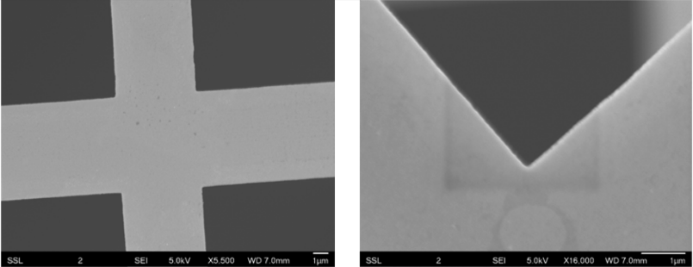
Published Results
Free-standing grid fabricated for use as resolution standard in proton beam writing system
Free-standing Ni resolution standard for sub-30 nm dimensions in 2005 [1]
Orthogonal Ni grid with 500 nm thickness achieved in 2013 [2]
Au grid with 190 nm thickness used to achieve 23 nm spot size in 2019 [3]
Achieved 6 × 10 nm lateral resolution in 2023 using the above grids for focusing [4]
Current Uses
Same grid used for more than 5 years without degrading performance in CIBA PBW system
For production of nanofluidic chip master stamps, imaging, etc.
Potential
Consistent production of grids with proven high resolution capability
Tried-and-tested SOP for production
Proven track record of consistent small beam spot sizes with heavy usage over a decade
Resolution Standards
Summarised Grid Production Process
PMMA
Cr, Au, Cu seed layers
Substrate
PBW and PMMA development
Metal plating
PMMA removal
Cu removal, free-standing metal grid
[1] J. A. van Kan et al. Fabrication of a free standing resolution standard for focusing MeV ion beams to sub 30 nm dimensions (2005)
[2] Y. Yao et al. Improved beam spot measurements in the 2nd generation proton beam writing system (2013)
[3] S. Qureshi et al. Automated alignment and focusing system for nuclear microprobes (2019)
[4] Y. X. Dou et al. Breaking the 10nm barrier using molecular ions in nuclear microprobes (2023)
SEM image of Au grid showing orthogonality (left) and smoothness (right) of grid bars [3]

